Slide 1
Layers of a Service-Oriented Architecture

Slide 2
Outline
Objectives
On completing this module, you will be able to:
Understand the concept of atomic/simple (micro)services and composite/complex (micro)services
Understand sample layers in a service-oriented architecture (SOA)
Understand where microservices reside within an SOA layered architecture.
Understand the benefits of a layered SOA for developing enterprise solutions
Topics
Services, Microservices
Atomic/simple and composite/complex microservices
SOA Layers

Slide 3
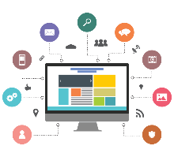

Definition of a Service in the Software World
A service may be defined as:
A unit that provides one or many functionalities needed to support business requirements and can be used by other applications or services over the network via a standard interface that is independent of programming languages and platforms
Input
e.g. search for a book
Service
Consumer
Interface
Service
Provider
Interface
F1
F2
e.g. order a book
Application 2
Output
Application 1
Service Consumer
(consumer)
Service Provider
(server)
The Service Provider Interface and the Service Consumer Interface refer to some code that is at the provider and consumer end respectively and enables data exchange between the provider and the consumer.
Notes:
The unit can be a monolithic application or a mini-application. The application can be a COTS, a custom app, or a legacy app.
The functions in the server are said to be exposed as a service if it provides a standard interface for others to use the functionalities.
Web service provides a standard interface over the web/internet.
Q: is a REST API a service?
Yes. It is also often called a web service, since its main technology is "web-friendly" (i.e., HTTP); while AMQP-based (micro)services are generally not called web services.
Q: is a REST API a microservice?
It depends on its internal implementation/deployment, to see if it depends on certain monolith;
The consumers wouldn't know just by looking at the API itself.

Slide 4
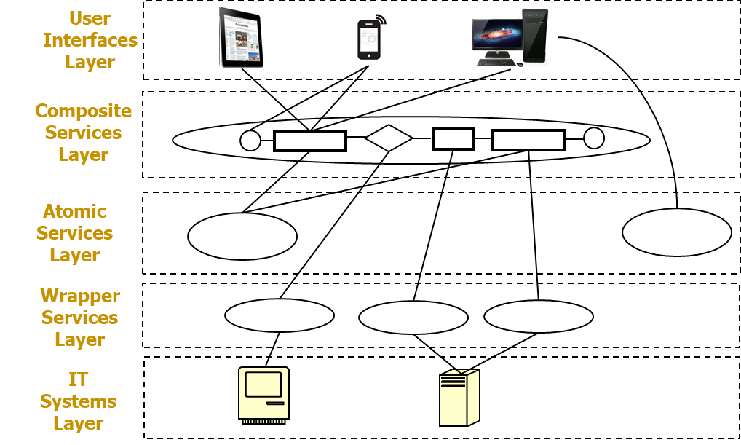
Service-Oriented Architecture
Consider turning all IT systems into services
Each service can be small, simple, or large, complex
Develop and maintain enterprise solutions as assemblies of loosely-coupled services
Manage assemblies at various layers of different functionality and/or complexity. Sample layers:
Notes:
The functionality from lower layers can be reused by higher layers, saving the efforts needed to develop the functionalities need by the higher layers.
Each unit in each layer may be developed and maintained by different teams.
A composite service can be referred to as a process service too when it closely corresponds to a business process.

Slide 5
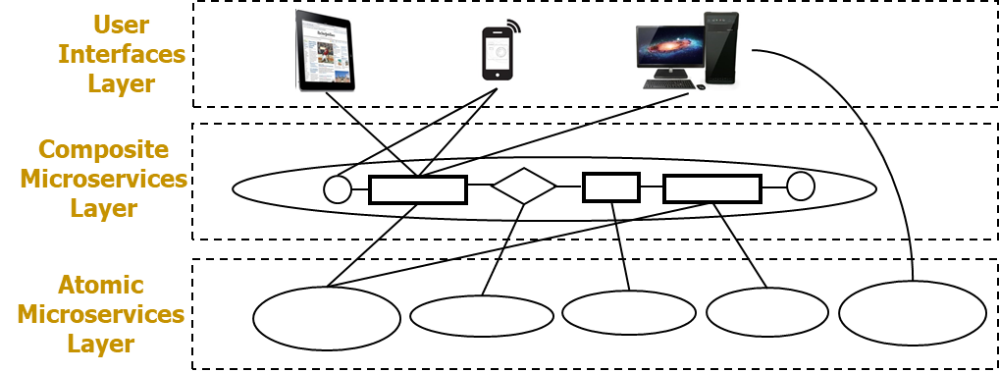
Microservices and MSA Revisit
A microservice may be defined as:
A service that can be independently developed and deployed and provides one or a few functionalities needed to support business requirements
Develop and maintain enterprise solutions as assemblies of loosely-coupled microservices
Provide all functionalities needed as microservices
Each microservice is relatively small, simple
Sample SOA layers with microservices:
Notes:
A service can be considered as a microservice if the code implementing the functionality of the service is NOT monolithic and can be easily deployed and scaled.
A composite microservice can be referred to as a process microservice too when it closely corresponds to a business process.

Slide 6
Types of (Micro)Services
Atomic (Micro)Service (a.k.a. Simple (Micro)Service)
“Atomic” implies that the (micro)service implements the expected functionalities by itself independent of other (micro)services or applications within an enterprise context (except for commonly used applications, such as Apache HTTP server, MySQL server)
An atomic microservice is often simple, providing one or a few functionality related to one kind of entity of a business concern (e.g., Book, Customer, etc.); the operations provided by the microservice are often simple CRUD of the data entities.
An atomic service may be complex, providing many functionalities involving multiple kinds of entities, which is not recommended by Microservices Architecture.
Wrapper Service
It usually does not provide new functionalities; it mainly exposes some functionalities of another application (e.g., a legacy system, an external system) as a service.
Composite (Micro)Service (a.k.a. Complex (Micro)Service)
“Composite” implies that the (micro)service implements the expected functionalities by composing a set/sequence of other services or applications together according to a business process (e.g., Place an order, Process a shipping record, Restock inventory)
The composition is often implemented via inter-process communication (IPC) technologies
A composite (micro)service are often called process (micro)service as it is often used to implement a business process involving more than one kinds of data entities.
A composite microservice may use other (micro)services, but not a monolith directly.
A composite service may use other (micro)services or a monolith directly, which is not recommended by Microservices Architecture
Notes:
An “atomic“ (micro)service often means a self-contained single unit that may not be further broken down into smaller units to be beneficial for an enterprise.
It usually implements simple functionalities involving one kind of data entity.
It may not be completely self-contained; it can still depend on some other commonly used applications, e.g., MySQL, HTTP servers, as long as those applications are considered to be scalable and can be independently deployed and would have little impact on the implementation and deployment of the atomic (micro)service.
It may not invoke other (micro)services via HTTP, as invoking others would mean it depends on others' URLs;
It may not directly communicate to other (micro)services (later lectures will have more details about inter-process communication technologies (IPC))
it may still send reply data if requested; e.g., respond to an HTTP request, or send a reply message via AMQP
it may still send data out (e.g., publishing a message/event via AMQP), but should not need to directly know who the receivers are; the data sent out should not directly contain the receivers' information;
A “composite“ (micro)service often means some functionality that is composed from other (micro)services. The composition of (micro)services is often implemented via IPC, not via normal function calls.
It often involves functionalities that correspond to business processes, which are usually more complex than atomic (micro)services.
It invokes other (micro)services via HTTP, or directly communicates to others, e.g., by sending a request to a particular receiver and waiting for a reply
A composite (micro)service often needs to know the interfaces (e.g., URLs, routing keys, data formats) of all others it communicates with.
Composing directly with a monolith without a service interface is not recommended (although technically can be done), as that would increase coupling between the composite service and the monolith, making it harder to deploy/scale up the service independent of the monolith.
A better way is to first expose the monolith's functionality as a set of wrapper services, then build a composite microservice that indirectly composes the monolith via using those wrapper services.

Slide 7
Example: Microservice Interaction Diagram – Browse books
Book
1. Get all books
HTTP
2. Return a list of books
Amazing Bookstore UI
Browse books
Legend
Micro-service
External service
Notes:
Communication pattern: one-to-one, synchronous request-reply between UI and Book.
this Book is an atomic (simple) microservice

Slide 8


Example: Microservice Interaction Diagram – Place an order: Implementation with HTTP and AMQP
5. Send the newly created order
{ order }
Shipping Record
Order
2. Send the order information
{cart items}
3. Return the newly created order
{ order }
HTTP
6. Return the created shipping record or error
HTTP
AMQP
Place an Order
Activity Log
4. Send the order activity for recording
1. Send the order information
{cart items}
7. Return the created order and shipping record and/or error
HTTP
AMQP
3. or 6. If error from any service, activate the error handler
Error
Amazing Bookstore UI
Place an order
Producer/sender of request data
Consumer/receiver of request data
Notes:
"Place an Order" is a composite (complex) microservice. The other yellow boxes are atomic (simple) microservices in this case.
Sample communication patterns:
1+7 : one-to-one, synchronous RR
2+3 : one-to-one, sync RR
4 : one-to-one, fire & forget
5+6 : one-to-one, sync RR
"If error" (after 3. or 6.) : one-to-one, fire-forget (FF)
4+5 when an order is confirmed successfully: one-to-two
4+"If error" when an order fails to confirm : one-to-two

Slide 9
Microservice Attributes
Attribute | Atomic/Simple | Composite/Complex
Independently Deployable | Yes | Yes
Independently Scalable | Yes | Yes
Any Programming Language | Yes | Yes
Encapsulates… | … a single “atomic” entity (e.g., Customer, Product) | … a single process. It often orchestrates or aggregates other atomic/composite (micro)services.
Naming Convention | Noun E.g. book, order, shipping_record | Verb E.g. Place order, Process shipping
Can invoke other services | Never | Yes, that is its main purpose
Data ownership | Typically has exclusive ownership of the database tables for its data entities | Typically does not own data, but requests the data via the APIs of other services

Slide 10
Exercise
Suppose a retail organization has three composite microservices (orange) that consist of a sequence of activities (white) in each row. The activities may be implemented via some atomic or wrapper services (not necessarily microservices) that expose some functionalities from the IT systems (yellow). The systems may be monolithic.
Task: Add appropriate atomic or wrapper services, and reorganise the (micro)services and the systems into 3 layers in the template on the next slide and connect them based on possible interaction or communication among them.
1
2
Inquiry
Balance
Get
Cust
Account
Get
Account
Balance
Manage
Order
1
2
3
4
5
6
7
Get
Cust
Account
Get
Account
Balance
Check
Inventory
Get Cust
Address
Update
Inventory
Update
Order
Update
Account Balance
Inquire
Order
1
2
Get
Cust
Account
Get
Orders
Inventory
System
Order Mgmt
System
CRM
System
Accounting
System

Slide 11
Sample SOA Layers for the Activity
Inquire
Order
Composite Microservices
2
1
Orders
Cust Account
Wrapper Services
Inventory
System
Order Mgmt
System
CRM
System
Accounting
System
Orders
Cust Acc Num
IT Systems
Notes:
The IT Systems or applications act as data sources for the wrapper services. They may be monoliths without service interfaces (although they may provide APIs e.g., functions that can be invoked by other systems or services).
The wrapper services provide service interfaces for the monoliths, by accepting requests from other microservices or UIs, transforming data, and invoking some functionalities of the IT Systems/applications (often by invoking some APIs of the systems/applications directly).
The procedure (including needed coding) to provide a standard service interface for some functionalities of an IT system is called to expose the functionalities of a system as a service. This service is often called a wrapper service; although this service is often small and simple, it is usually NOT called a microservice because it depends on the IT system which may be a monolith, and it's not easy to just deploy the service itself without deploying the IT system together.
process service == composite microservice

Slide 12



Sample SOA Layers & Supporting Infrastructures for an Enterprise
API Gateway
User Interface Layer
Business Process Management
Composite Services Layer
(long-running processes)
Interactive
Auto
Auto
Enterprise Service Bus
Composite Microservices Layer
(straight-through processes)
Composite
Composite
Composite
Message Broker
Atomic Microservices Layer
Atomic
Atomic
Container Management
Wrapper Services Layer (Expose the functionality of Internal or External IT Systems)
Wrapper
Wrapper
Wrapper
Wrapper
…
IT Systems Layer
External Services
Notes:
The functionality from lower layers can generally be reused by higher layers, saving the efforts needed to develop the high layers.
It'd be easier to make changes to individual components in each layer due to reduced coupling.
The actual layers and their compositions may differ from one enterprise to another.
All the UIs may access service layers (not the IT systems layer) directly or via a gateway (e.g., the Kong API gateway in our labs for managing accesses to REST microservices).
Composite (micro)services can communicate with other (micro)services (not the IT systems or monoliths) directly or via an enterprise service bus (ESB).
A business process can be straight-through (i.e., can be fully automatable to run through multiple steps quickly without obvious pauses in the middle), or long-running (i.e.,, can take long time to run often because it involves large-scale data processing or human interactions in the middle of the process and need to pause in the middle to wait for human inputs or data that may only come at uncertain time). E.g.,
"Browse books" is a straight-through process; "Place an Order" in our scenario is straight-through (without considering the error handling, actual delivery, etc.);
"Process a Shipping Record" can be long-running when we consider the actual delivery as part of the process, since delivery often involves human operations and takes relatively long time to complete.
Beyond the course scope:
Composite (micro)services can be long-running processes. When there are many processes running at the same time, it'd be easier to manage all the processes using a dedicated Business Process Management Engine (BPME, or just BPE) as part of the large-scale enterprise solution.
There can be additional infrastructural layers (e.g., ESB) to help manage the (micro)services and the communications among them.

Slide 13
Sample SOA Layers & Supporting Infrastructures for an Enterprise
User Interface Layer(s)
Provides the interfaces for interactive activities with users
Can trigger a business process, which may trigger (micro)services
Do NOT invoke monoliths directly; only use monoliths indirectly via (micro)services
Business Process Layer(s)
A business process can be long-running involving user interactions (e.g., Loan Approval that requires a human approval) or straight-through (e.g., one-click ordering)
A business process can be implemented as a (micro)service, usually composite
Composite (Micro)Services Layer(s)
Can directly communicate to other (micro)services, but not to IT systems or monoliths
Atomic Microservices Layer(s)
An atomic microservice can be independently developed, deployable, and scalable
Do NOT directly communicate to other atomic (micro)services
Wrapper Services Layer(s)
A wrapper service exposes a functionality of an IT system or a monolith or an external system/service, and has higher dependency on them
IT Systems Layer(s)
Applications (COTS, Custom or Legacy) that provide one or many functionalities
Do NOT directly communicate to other layers
External Services Layer(s)
From third-parties beyond the control of the enterprise; may or may not be microservices
May be directly used by other layers if reliable, compatible, and easy to change
API Gateways
Manage accesses to (micro)services, usually for external service consumers
Business Process Management Software Suites (BPMS)
Manage business processes (including design, modelling, analysis, implementation, execution, monitoring, optimization, etc.)
Enterprise Service Buses
Manage accesses to (micro)services, usually for internal uses in an enterprise
Communication Technologies
Message brokers
HTTP servers
Container Management
Docker Compose, Kubernetes, …
Storage Servers
DBMS, SharePoint, Drive, …

Slide 14
Sample Benefits of Microservices and SOA Layers
Enforce a high degree of modularity and help to manage complexity in large enterprise solutions
Wrapper services are less modular than atomic microservices due to their direct dependency on the underlying (monolithic) applications
Microservices are loosely coupled from each other
Independently developed, deployable, scalable
(Micro)services interact with each other through standards-based interfaces
Independent of programming languages or platforms
Common errors (e.g., timeout, network interruption, wrong data format, etc.) may be handled in a standard way.
Easier to reuse a (micro)service than to reuse a monolith
Implementing a business process is like to assemble a composite (micro)service that reuses other (micro)services that may be implemented in different technologies.
Easier to change a (micro)service than to change a monolith
Easier to support continuous integration and deployment (CI/CD) for changing business requirements
Notes:
Drawbacks? Yes. There is overhead in developing a (micro)service than developing functions, and there are more moving parts to manage (e.g., more complex communication among services distributed across network), all requiring additional tools and costs.

